Slide 1

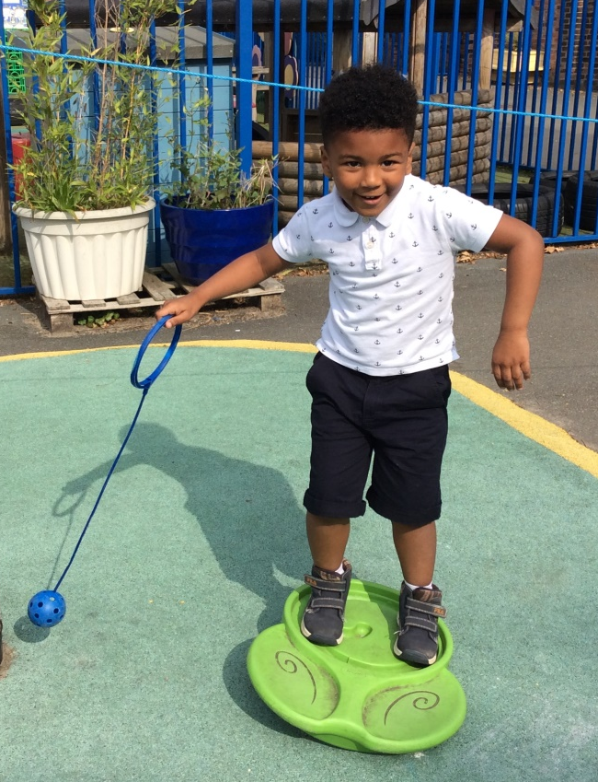
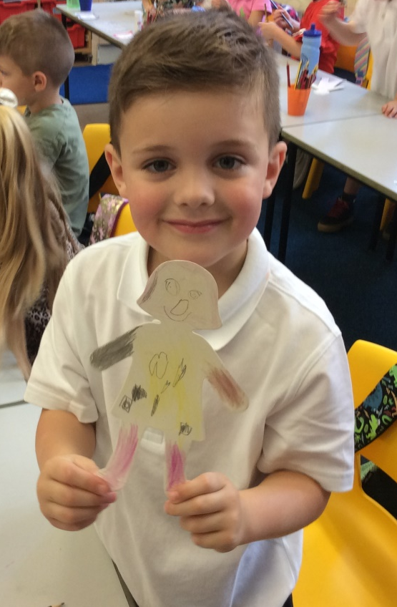
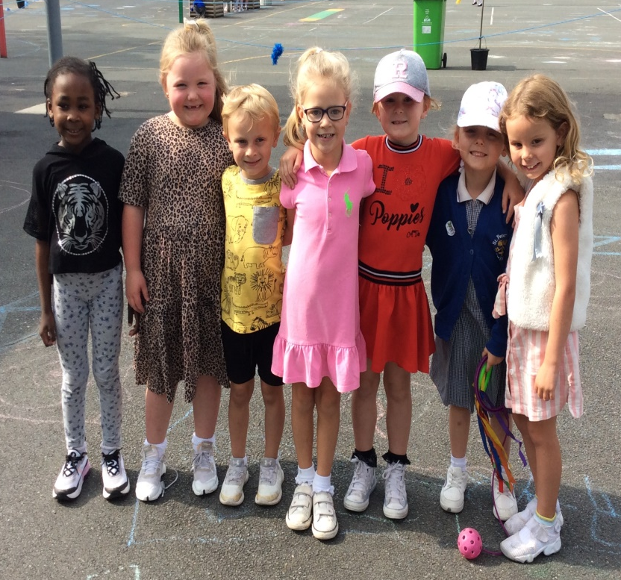
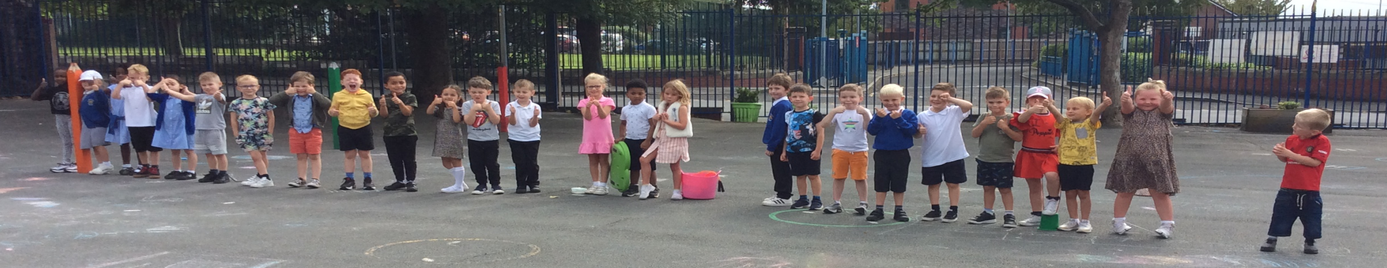
Welcome to Year 1!

Slide 2
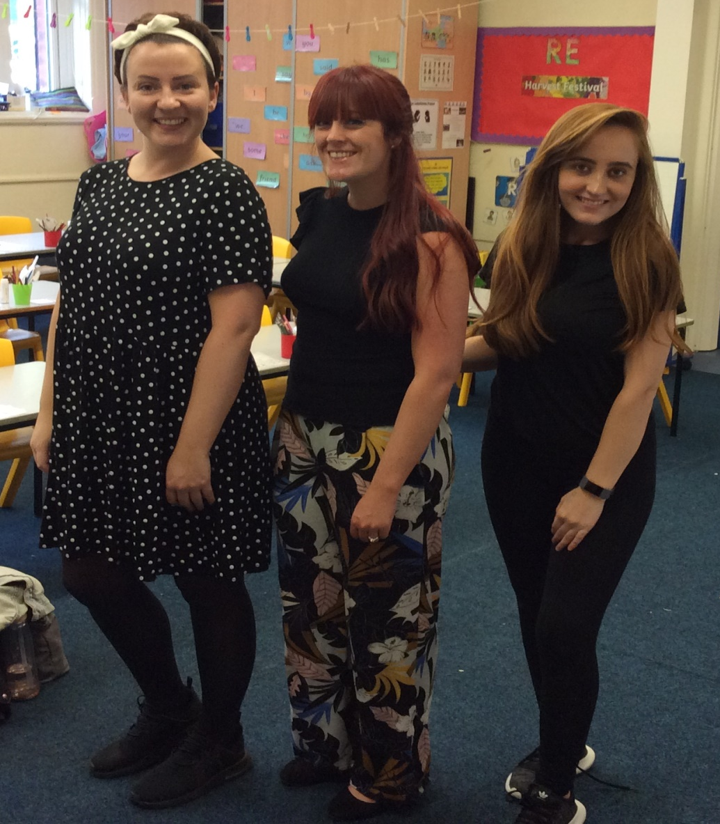
Our Staff☺
Mrs Green - Teacher
Miss Jones – Senior Teaching Assistant
Miss Meacher - Teaching Assistant (PM)

Slide 3
Reception to Year 1
The transition from Reception to Year 1 is managed in a gradual, staged approach, which allows the children to adapt during the first half of the Autumn Term. We will still be using continuous provision and completing learning activities through play.
Continuous provision is currently limited due to Coronavirus restrictions, so we have adapted many lessons instead. This means that lots of our Curriculum based lessons will involve lots of play activities. We have done this in order to keep the children and staff as safe as possible.
However, some children may still find the transition a little daunting and tiring at first. Therefore, early nights are a must!

Slide 4
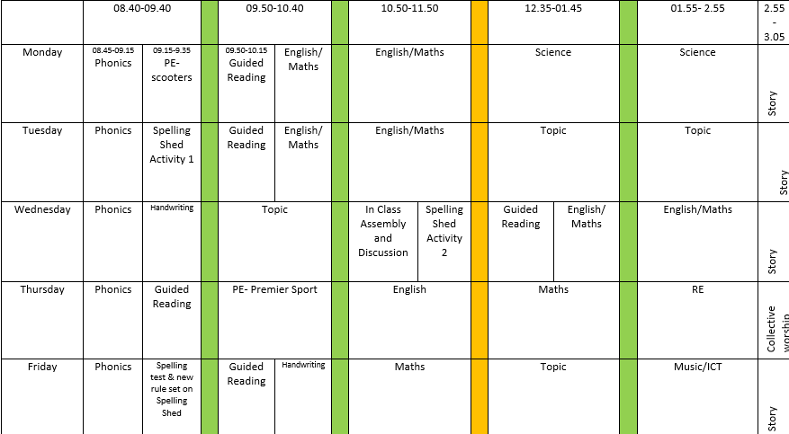
Our School Day
Currently, our timetable looks like this.

Slide 5

The National Curriculum
English
Maths
Science
History
Geography
Religious Education
Art and Design
Design and Technology
Computing
Music
Physical Education
Personal, Social, Health and Economic Education
In Year One, we follow the National Curriculum to do our learning. We are going to learn all of these exciting subjects throughout the year.

Slide 6




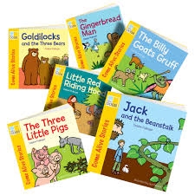

Year 1 Terrific Topics!
Autumn 1: Superhero Me
Autumn 2:Polar Explorers
Spring 1: Happily Ever After
Spring 2: Lowry vs Banksy
Summer 1: Man on the Moon (Space)
Summer 2: African Adventure

Slide 7


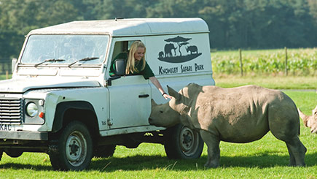
Seasons
As well as all of these exciting topics, we will also spend the last week of every term focusing on ‘Seasonal Changes’.
Proposed trips and exciting activities
Knowsley Safari Park
Nurse visit (Discussing health)
PE with Miss Simpson
Eureka!
A walk around Swinton
Class Assembly
Superhero dress up day
Hopefully, we can do some of these exciting things, later on in the school year.

Slide 8
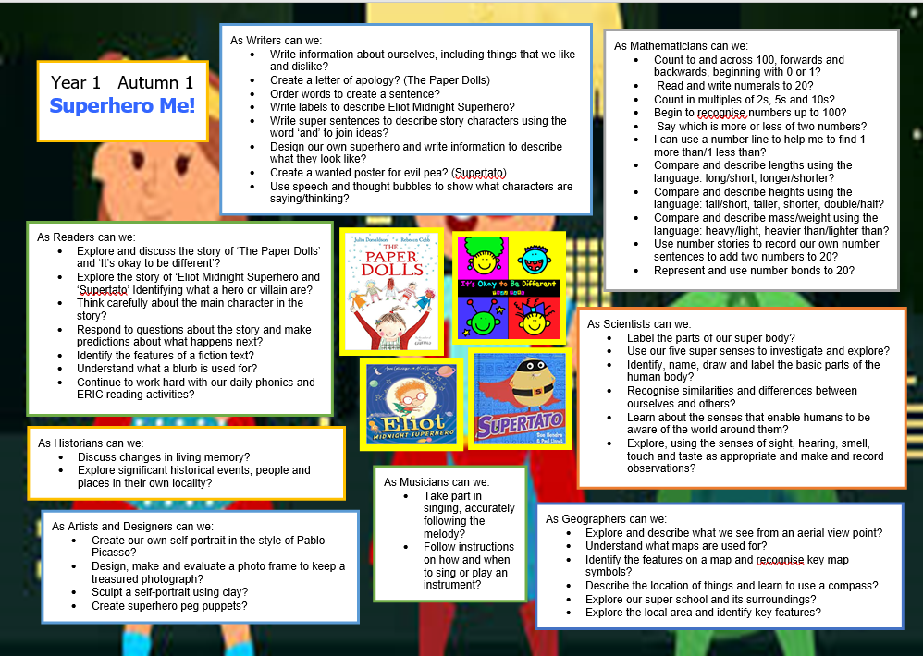
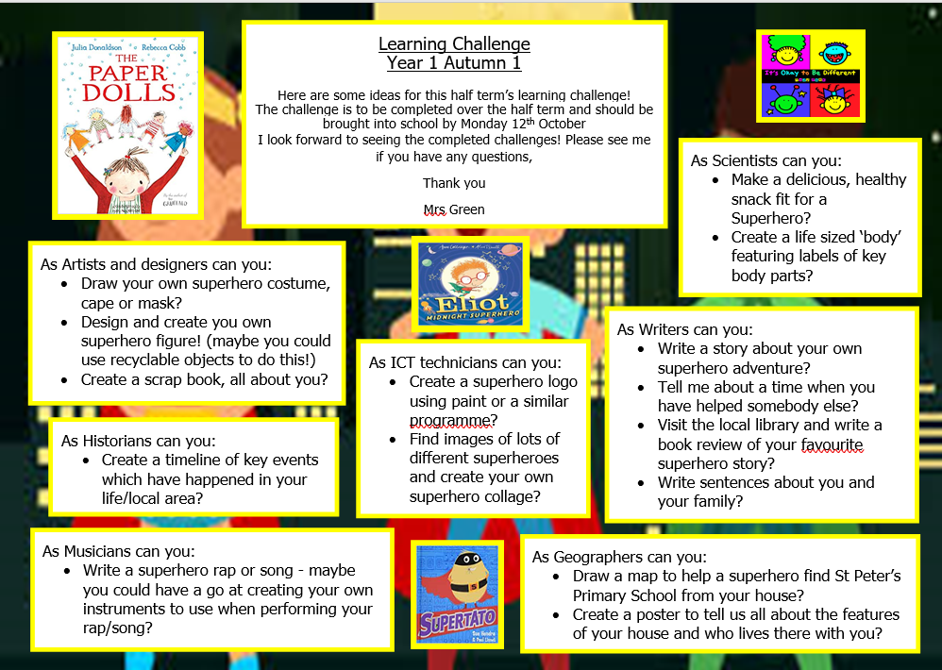
Our topic this term is:
Superhero Me!
Home learning Challenges

Slide 9

Homework
Reading every night
Unfortunately, individual reading books can’t be sent home at the moment due to the Covid restrictions. Instead, the children are allowed to chose a free reading book, which matches their reading level. Once it has been read a few times, the book needs to be returned to school (to be quarantined) and another book will be allowed to be taken home.
2. Phonics homework is sent out every Friday and is to be handed in the following Thursday.
3. Our Spelling test is every Friday.
On Fridays, the children will bring home their new spellings (on yellow paper) to practise. The yellow sheet doesn’t need to be brought back to school, but can be used at home to practise their spellings as many times as they wish.

Slide 10
ERIC
(Every child Reading in Class)
In Year One, the children take part in daily reading activities for 20/30 minutes:
Throughout the week they will take part in different reading activities:
1. Guided Reading- Completed with the Class Teacher.
2. Phonics/DIAL activities- Completed independently. The activities are based on the children’s phonic stage/understanding.
3. Individual Reading- Completed with a Teaching Assistant.
4. Phonics Play- Completed independently on an Ipad.
5. Free Reading- Children have the choice to read from a range of exciting fiction and non fiction books.

Slide 11
ERIC
(Every child Reading in Class)
As part of our commitment to reading in our school it is extremely important that the children ‘re-read’ their reading books that they bring home a minimum of 3 times before they change it in school –
They apply their phonics to help them to decode words that are unfamiliar to them when they first read a book
Comprehension – they need to show a good understanding of the book they are reading and answer questions about the events in the story, the characters etc
Fluency – After becoming familiar with the book the children then become confident with both understanding the story and reading the words – if they are reading the book fluently then it’s time for them to change it.

Slide 12
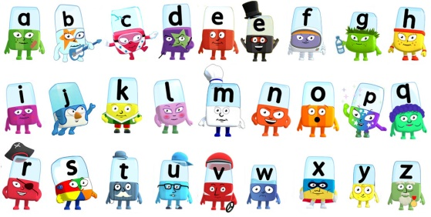
Phonics Screening Check
^{Why Phonics Screening?}
• The phonics screening check is taken individually by all children in Year 1 in England.
• It is designed to give teachers and parents information on how your child is progressing in phonics
• It will help to identify whether your child needs additional support at this stage so that they do not fall behind in this vital early reading skill.
What will the Phonics Screening Check look like?
There will be two sections in this 40-word check and it will assess phonics skills and knowledge learned through Reception and Year 1.Your child will be expected to read 20 real words and 20 nonsense words which are referred to as pseudo-words.
More information will be provided on the phonics Screening Check later this year.

Slide 13
Any other information…
If any of the children have any allergies, please could you let a member of staff know.
As Mr Wright mentioned via text, our PE lesson is currently on a Thursday morning. For now, it makes sense for the children to come to school on Thursdays, in their PE kits.

Slide 14
Thank you for your reading the PowerPoint. So far, all the children have settled in brilliantly and I am looking forward to an exciting year ahead!
If you have any questions, please feel free to ask Mrs Green or Miss Jones, during the morning drop off or alternatively email Mrs Green at:
lauren.unwin@salford.gov.uk

Slide 15


